Slide 1
Dynamic Programming
2016-22447
Water Resource System Engineering
YOON, HAE NA

Slide 2
Definition
Dynamic programming is an approach that divides the original optimization problem, with all of its variables, into a set of smaller optimization problems.
original optimization problem
smaller optimization problem
m
:possible discrete states
…
Stage(j) : 1, 2, ,…, n
Decision(j): x₁, x₂, ,…, x_{n}
State(j) : S₁, S₂, ,…, S_{n}
m^{n} calculation : ‘curse of dimensionality’

Slide 3
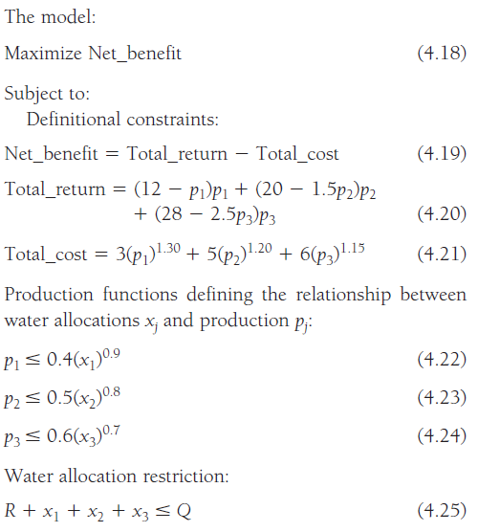
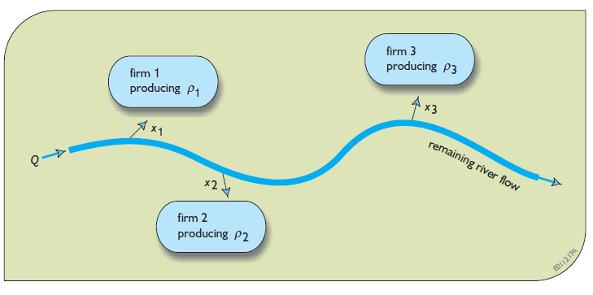
“Water Allocation Example”
Solve This Problem
by Dynamic Programming
Equations from Ch. 4-3

Slide 4
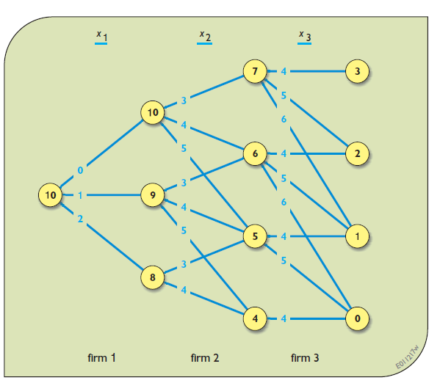
Water Allocation Example
Variables
x_{j} (decision variable (water allocation at firm j))= 0~10
S_{j} (discrete state j (water amount))= S_{j-1}-x_{j-1}
where S₁=10
→ 본 문제에서 문제의 단순화를 위해 다음과 같이 변형
Link
x₁ | x₂ | x₃
0 | 3 | 4
1 | 4 | 5
2 | 5 | 6
총 3^3=27가지
Node
S₁ | S₂ | S₃ | S₄
10 | 10 | 7 | 3
 | 9 | 6 | 2
 | 8 | 5 | 1
 |  | 4 | 0
Discretized

Slide 5
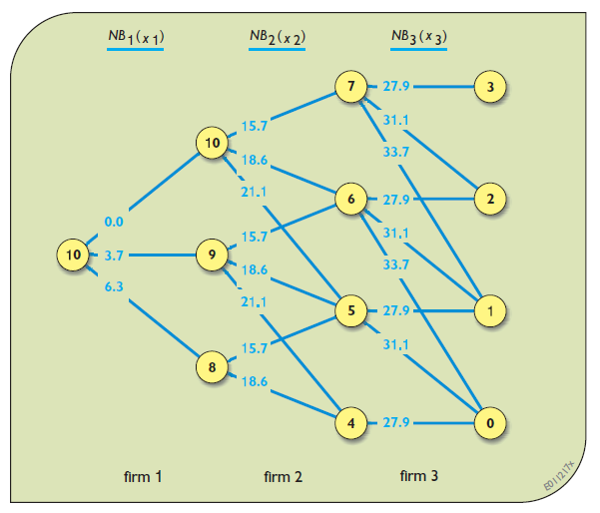
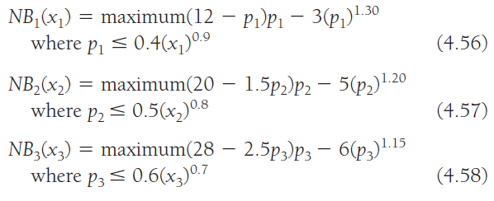
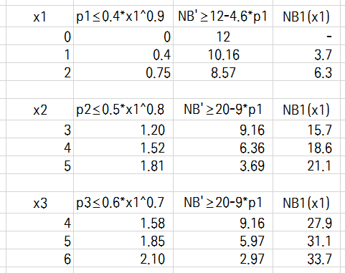
Water Allocation Example
Net Benefits (of each state j)
(단조증가)

Slide 6

Water Allocation Example
Objective
How to Solve ??
Backward-moving
(Forward-looking)
Forward-moving
(Backward-looking)

Slide 7
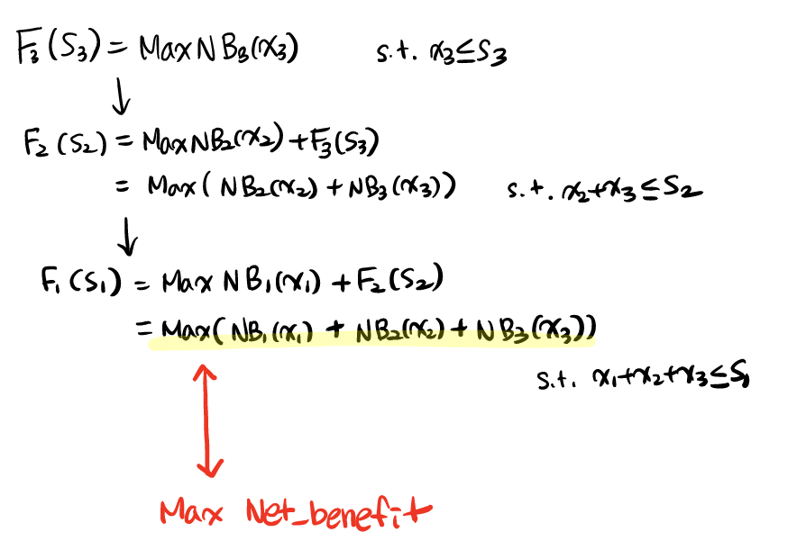
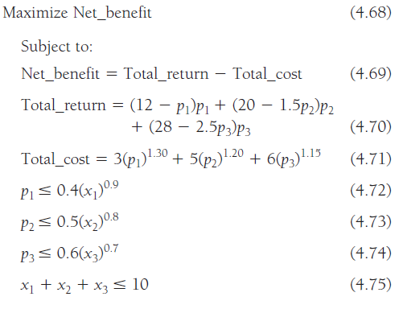
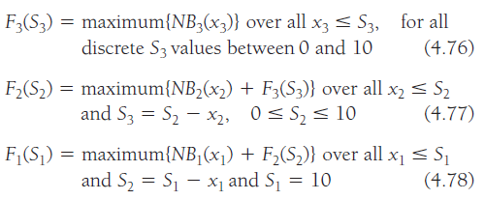
Water Allocation Example
Solving Method
Backward-moving (Forward-looking)
Equations

Slide 8
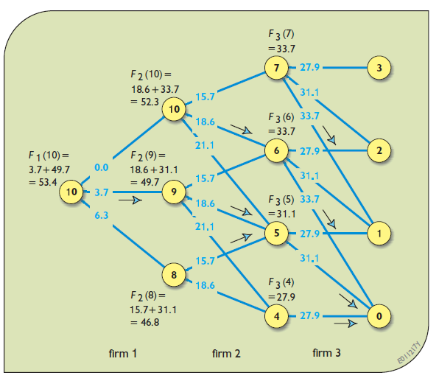
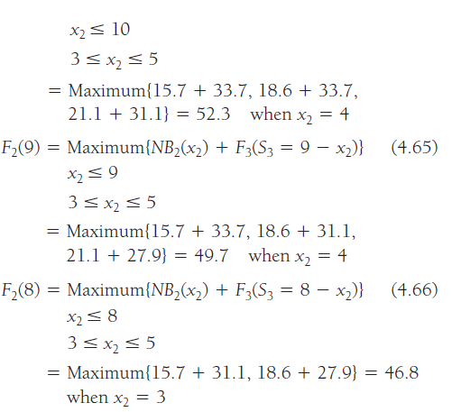
Water Allocation Example
Solving Method
Backward-moving (Forward-looking)
① Maximum{NB3(x3)}
② Maximum{NB2(x2)+NB3(x3)}
49.4
③ Maximum{NB1(x1)
+NB2(x2)+NB3(x3)}
52.3
52.2
49.4
49.7
Initial value=0
49.0
46.8
46.5

Slide 9
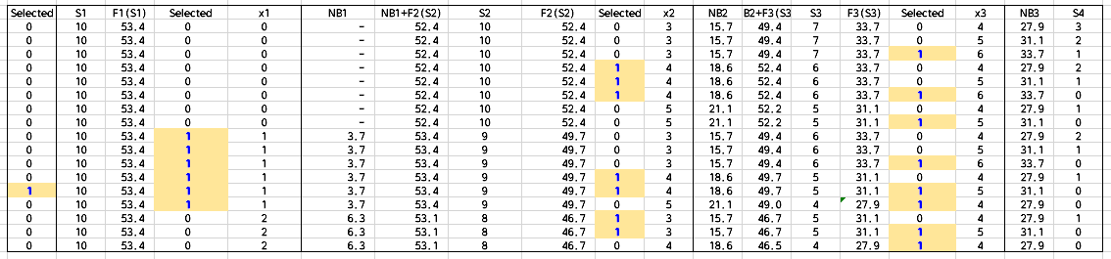
Water Allocation Example
Solving Method
Backward-moving (Forward-looking)
By excel calculation

Slide 10

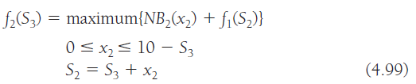
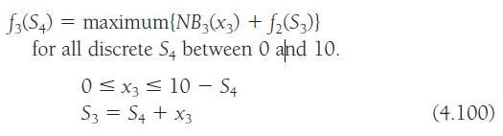
Water Allocation Example
Solving Method
Forward-moving (Backward-looking)
Equations

Slide 11
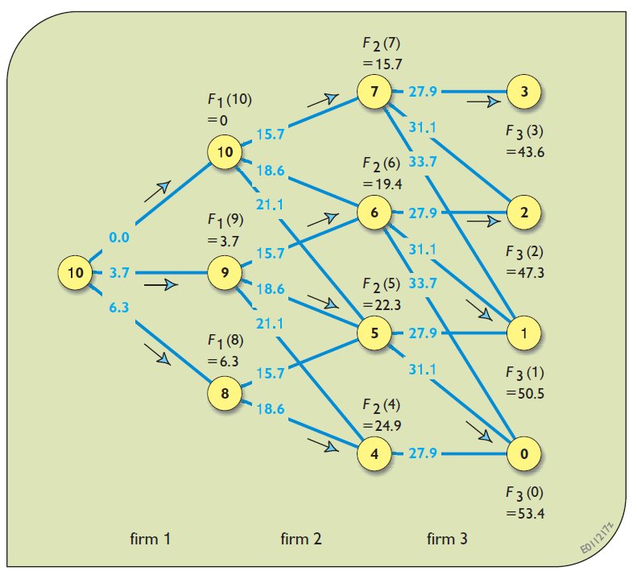
Water Allocation Example
Solving Method
Forward-moving (Backward-looking)
③ Maximum{NB1(x1)
+NB2(x2)+NB3(x3)}
② Maximum{NB2(x2)+NB3(x3)}
46.8
① Maximum{NB1(x1)}
49.4
47.3
19.4
50.5
22.3
53.1
Initial value=0
24.8
50.2
22.0
53.4
24.9
52.8

Slide 12
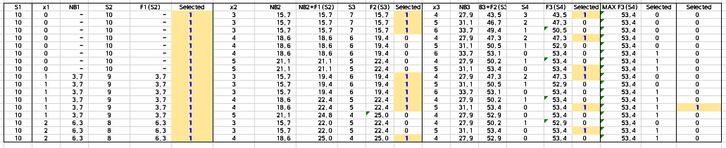
Water Allocation Example
Solving Method
Forward-moving (Backward-looking)
By excel calculation

Slide 13


“Capacity Expansion”
How much infrastructure should be built, when and why?
Variables
D_{t} : The capacity needed at the end of each future period t
C_{t}(s_{t}, x_{t}) : The cost of adding capacity x_{t} in each period t
x_{t}: adding capacity
s_{t}: existing capacity at the beginning of the period
Objective
Capacity not needed immediately
but expected to be needed eventually to meet an increased demand for additional capacity in the future
Constraints
Capacity expansion planners need to consider the future
if their plans are to be cost-effective.

Slide 14
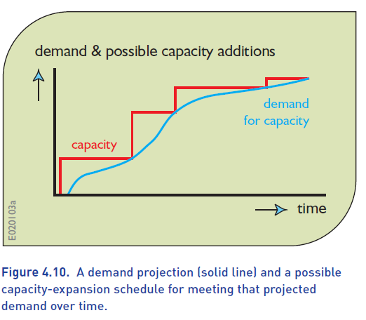
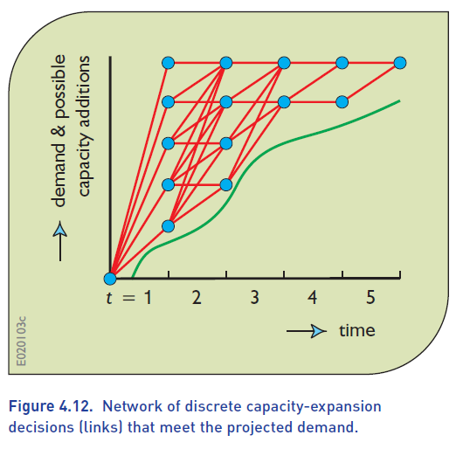
Capacity Expansion

Slide 15

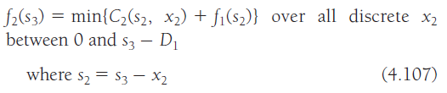
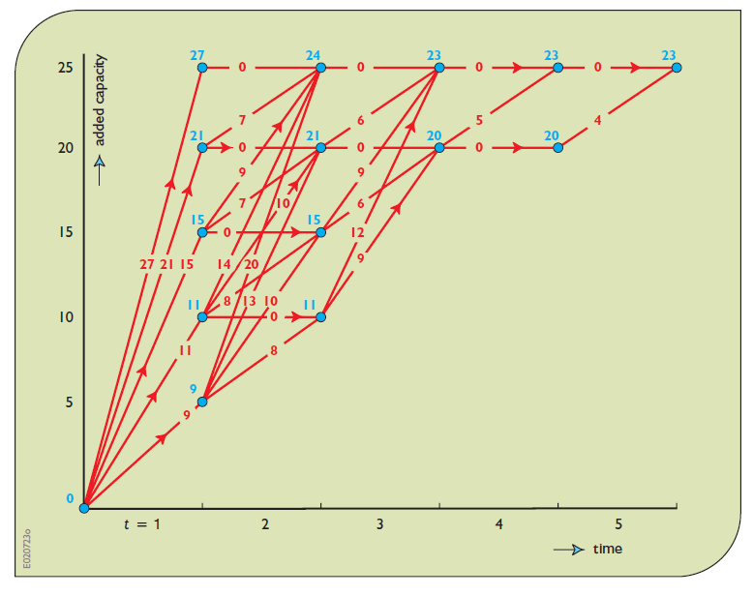
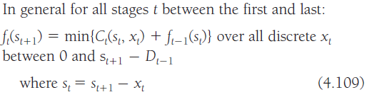
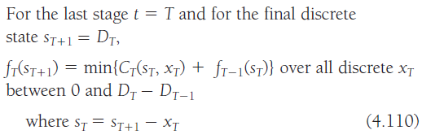
Capacity Expansion
Solving Method
Forward-moving (Backward-looking)
D_{t-1}≤ s_{t}≤D_{T}
D_{T}에 이르렀음 !
…
…
s₁=0

Slide 16
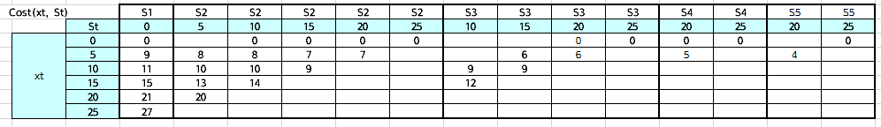
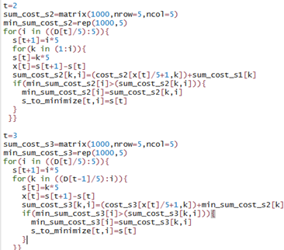
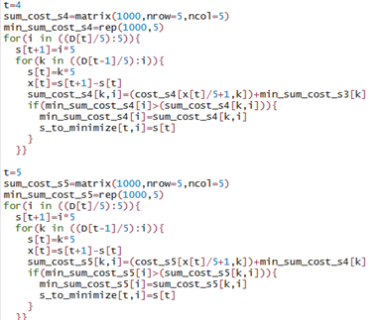
Capacity Expansion
Solving Method
Forward-moving (Backward-looking)

Slide 17

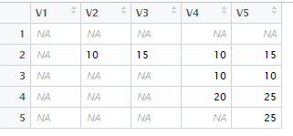
Capacity Expansion
Solving Method
Forward-moving (Backward-looking)
X1=10, x2=0, x3=10, x4=0, x5=0
27
24
23
23
23
21
21
20
20
15
15
s_to_minimize
11
11
9

Slide 18
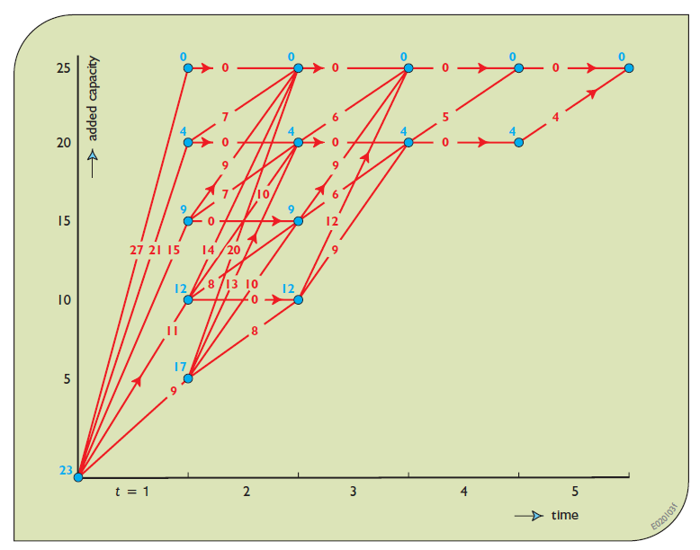
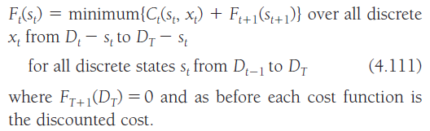
Capacity Expansion
Solving Method
Backward-moving (Forward-looking)
D_{t-1}≤ s_{t}≤D_{T}
F_{T+1}(D_{T})=0
s₁=0

Slide 19
Capacity Expansion
Solving Method
Backward-moving (Forward-looking)
# backward
min_sumcost_back=matrix(1000,nrow=6,ncol=6)
#initial condition
min_sumcost_back[6,6]=0
for (t in (5:2)){
for (i in ((D[t-1]/5+1):6)){
for (k in (i:6)){
s[t+1]=5*(k-1)
s[t]=5*(i-1)
x[t]=s[t+1]-s[t]
sumcost_back[i,k,t]=min_sumcost_back[k,t+1]+cost[x[t]/5+1,s[t]/5,t]
if(min_sumcost_back[i,t]>sumcost_back[i,k,t]){
min_sumcost_back[i,t]=sumcost_back[i,k,t]
s_to_minimize[i,t]=s[t]
}
}}}
t=1
for (k in (2:6)){
s[t+1]=5*(k-1)
s[t]=0
x[t]=s[t+1]-s[t]
sumcost_back[1,k,t]=min_sumcost_back[k,t+1]+cost[x[t]/5+1,1,t]
if(min_sumcost_back[1,t]>sumcost_back[1,k,t]){
min_sumcost_back[1,t]=sumcost_back[1,k,t]
s_to_minimize[1,t]=s[t]
}
}

Slide 20
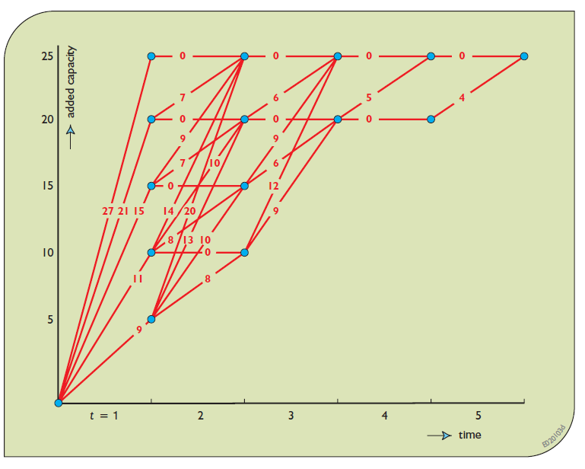
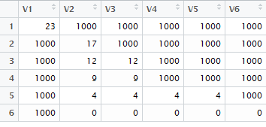
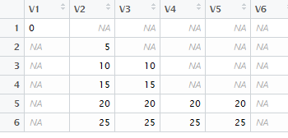
Capacity Expansion
Solving Method
Backward-moving (Forward-looking)
X1=10, x2=0, x3=10, x4=0, x5=0
min_sumcost_back
0
0
0
0
0
4
4
4
4
9
9
12
12
s_to_minimize
17
23

Slide 21
“Reservoir Operation”
About Reservoir Operation
Reservoirs designed to meet demands for water supplies, recreation, hydropower, the environment and/or flood control need to be operated in ways that meet those demands in the most reliable and effective manner.
Release rules may also specify the desired storage level for the time of year. The operator is to release water as necessary to achieve these target storage levels.
Does not vary from one year to the next. The actual releases will vary, however, depending on the inflows and storage volumes that actually occur.
Policy objectives could be the maximization of expected annual net benefits or the minimization of deviations.

Slide 22
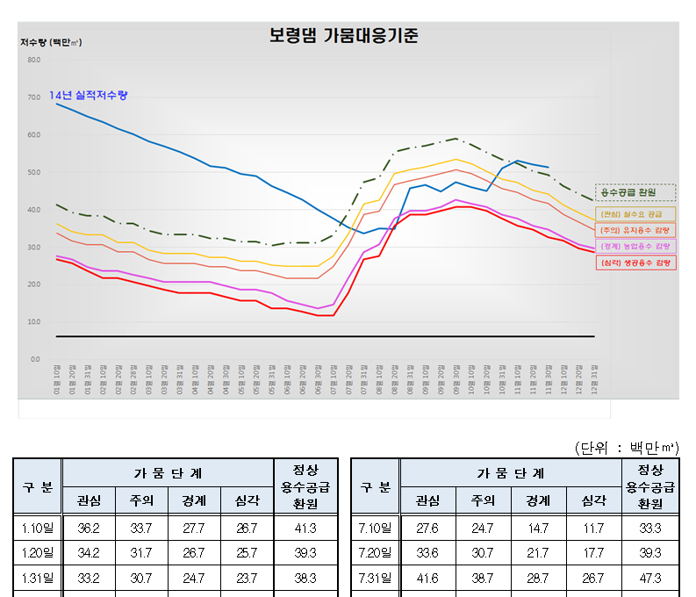
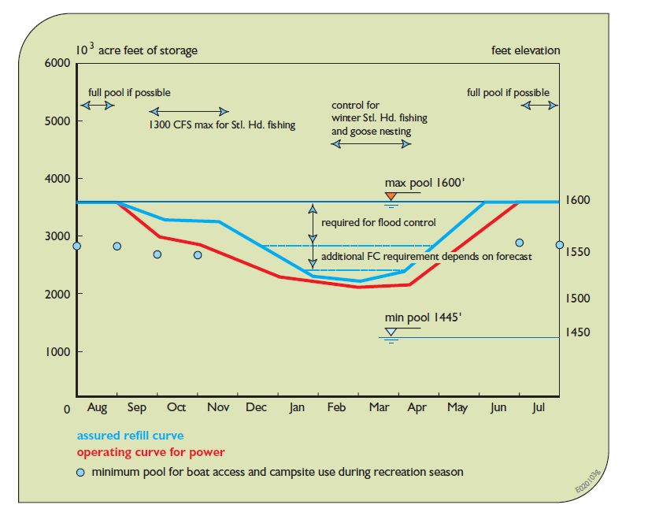
“Reservoir Operation”
Reservoir Operation Rule

Slide 23
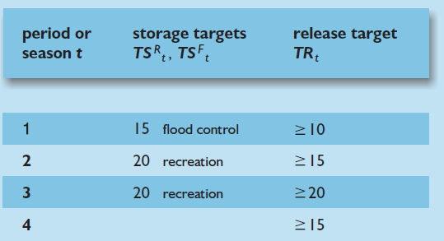





Reservoir Operation
Variables
Q_{t} : Mean Inflow
L_{t}(S_{t}, S_{t+1}) : The evaporation and seepage losses that depend on the storage volume in the reservoir
S_{t}: Storage volume
R_{t}: Release
Objective
Constraints
t | ws_{t} | wf_{t} | wr_{t}
1 | 0 | 1 | 1
2 | 1 | 0 | 1
3 | 1 | 0 | 1
4 | 0 | 0 | 1
↔ DR_{t}=max(TR_{t}-R_{t},0)=Deficit Release
↔ ES_{t}=max(S_{t}-TS_{t},0)=Excess Storage
↔ S_{t+1}≥0
↔ S_{t+1}≤0

Slide 24
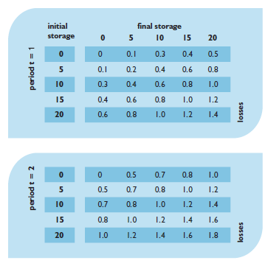
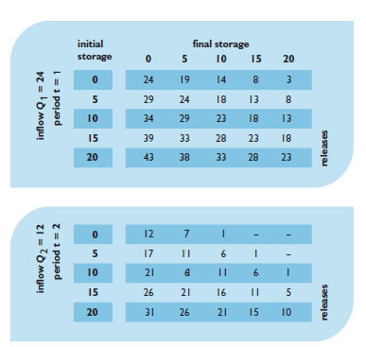
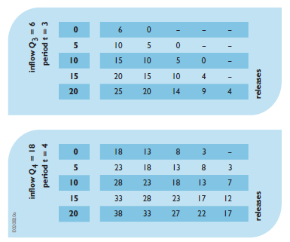
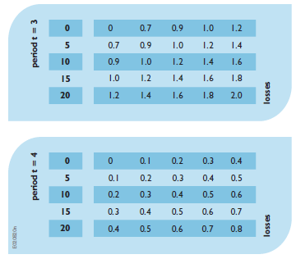
Reservoir Operation
Steady-state policy
매년 동일한 운영방법으로 운영될때까지 DP를 반복했을 때, 얻어지는 운영방법
TSD_{t}가 연간 일정 (매년 유입량이 일정할 때)
Data
Inflow
Losses
t | 1 | 2 | 3 | 4
Q | 24 | 12 | 6 | 18

Slide 25
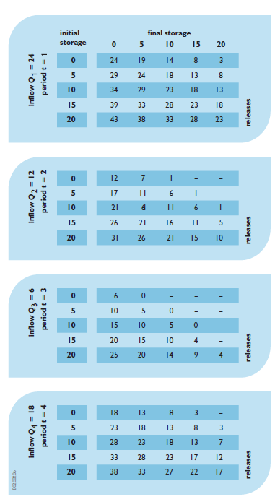
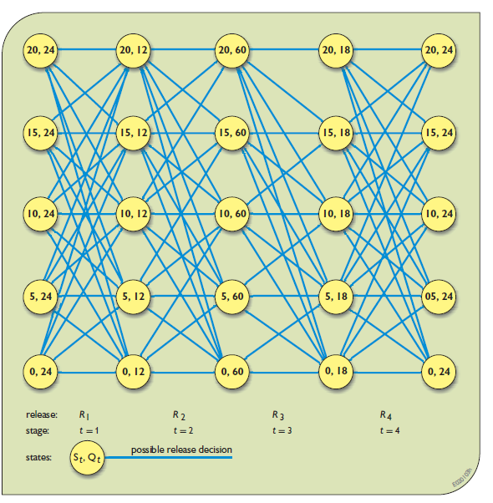
Reservoir Operation
Solving Method
Backward-moving (Forward-looking)
L=read.csv("D:/lose.csv")
Q=c(24,12,6,18)
S=rep(NA,5)
R=array(rep(NA,100),dim=c(5,5,4))
for(t in (4:1)){
for(j in (1:5)){
for(i in (1:5)){
S[t+1]=5*(j-1)
S[t]=5*(i-1)
a=S[t]+Q[t]-L[i,(t-1)*5+j]
R[i,j,t]=max(min(S[t]-S[t+1]+Q[t]-L[i,(t-1)*5+j],a),a-20)
}
}
}

Slide 26
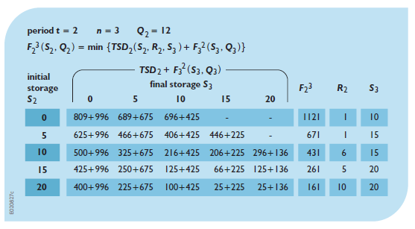
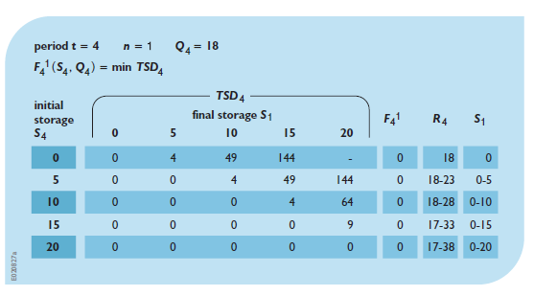
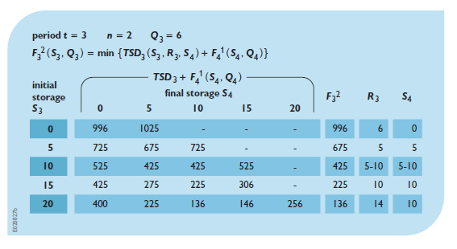
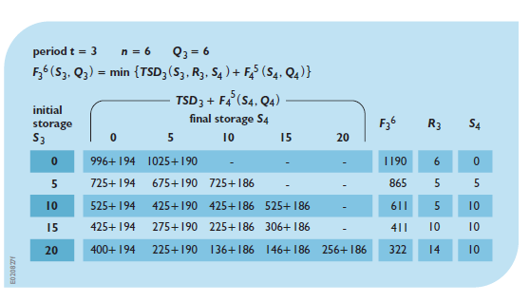
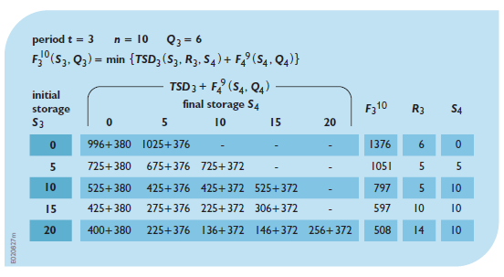
Reservoir Operation
Solving Method
Backward-moving (Forward-looking)
…
…

Slide 27
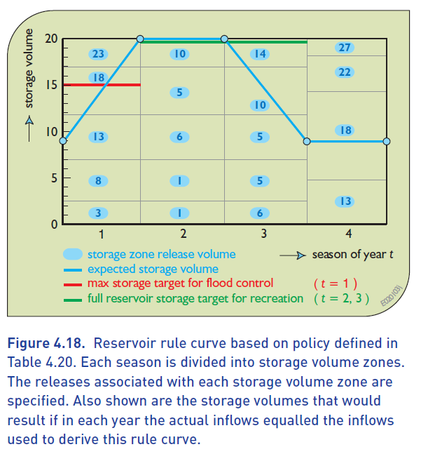
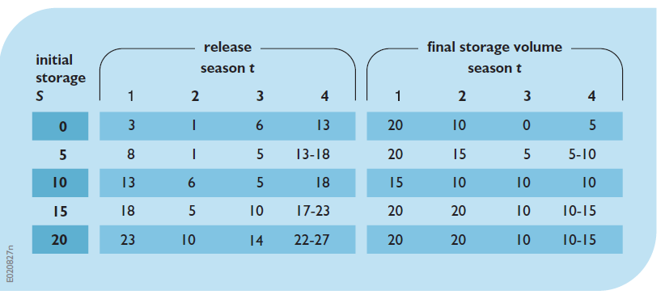
Reservoir Operation
Solving Method
Backward-moving (Forward-looking)

Slide 28

Reservoir Operation
for(r in (1:4)){
for(t in (4:1)){
k=k+1
l=l+1
for(i in (1:5)){
for(j in (1:5)){
S[i,j,t+1]=5*(j-1)
S[i,j,t]=5*(i-1)
a=S[i,j,t]+Q[t]-L[i,(t-1)*5+j]
R[i,j,t]=max(max(min(S[i,j,t]-S[i,j,t+1]+Q[t]-L[i,(t-1)*5+j],a),a-20),0)
ES[t]=max(0,S[i,j,t]-TSF[t])
ES[t+1]=max(0,S[i,j,t+1]-TSF[t+1])
DR[t]=max(0,TR[t]-R[i,j,t])
if(max(min(S[i,j,t]-S[i,j,t+1]+Q[t]-L[i,(t-1)*5+j],a),a-20)<0){
TSD[i,j,t]=99999 } else{
TSD[i,j,t]=ws[t]*((TSR[t]-S[i,j,t])^2+(TSR[t]-S[i,j,t+1])^2)+wf[t]*(ES[t]^2)+wf[t+1]*(ES[t+1]^2)+wr[t]*DR[t]^2+F_[j,k-1] } }
F_[i,k]=min(TSD[i,,t])
for(j in (1:5)){
if(F_[i,k]==TSD[i,j,t]){ RR_mn[i,j,t]=R[i,j,t] }
else{ RR_mn[i,j,t]=1000 }
R_mn[i,l]=min(RR_mn[i,,t])
}
for(j in (1:5)){
if(F_[i,k]==TSD[i,j,t]){ RR_mx[i,j,t]=R[i,j,t] }
else{ RR_mx[i,j,t]=0 }
R_mx[i,l]=max(RR_mx[i,,t])
}
L=read.csv("D:/lose.csv")
Q=c(24,12,6,18)
S=array(rep(NA,100),dim=c(5,5,5))
R=array(rep(NA,100),dim=c(5,5,4))
ws=c(0,1,1,0,0)
wf=c(1,0,0,0,1)
wr=c(1,1,1,1,1)
TSR=c(0,20,20,0,0)
TSF=c(15,0,0,0,15)
TR=c(10,15,20,15,10)
F_=matrix(0,nrow=5,ncol=20)
k=1
ES=c(0,0,0,0,0)
DR=c(0,0,0,0)
TSD=array(rep(NA,100),dim=c(5,5,4))
l=0
F_[,1]=c(0,0,0,0,0)
R_mn=matrix(0,nrow=5,ncol=20)
R_mx=matrix(0,nrow=5,ncol=20)
RR_mn=array(rep(NA,100),dim=c(5,5,4))
RR_mx=array(rep(NA,100),dim=c(5,5,4))
S_mn=matrix(0,nrow=5,ncol=20)
S_mx=matrix(0,nrow=5,ncol=20)
SS_mn=array(rep(NA,100),dim=c(5,5,4))
SS_mx=array(rep(NA,100),dim=c(5,5,4))
Solving Method
Backward-moving (Forward-looking)

Slide 29
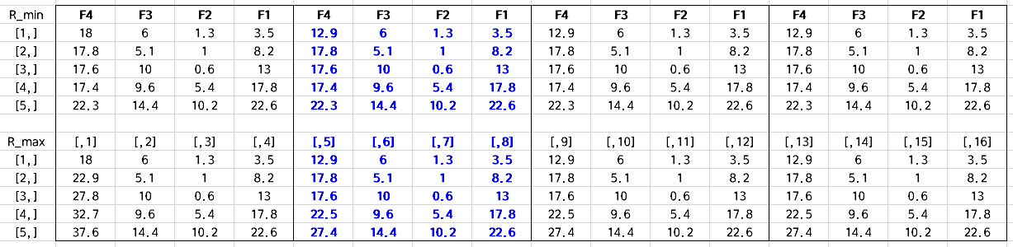
Reservoir Operation
R

Slide 30
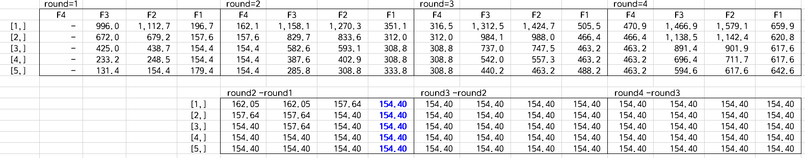
Reservoir Operation
F

Slide 31
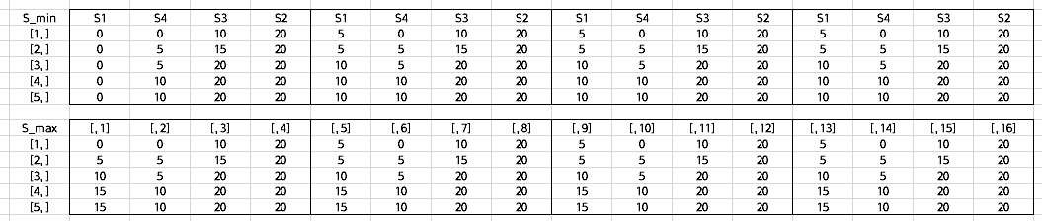
Reservoir Operation
S

Slide 32

Thank You!

